Slide 1
Describing more conversions with ratio
Task A: Interpreting and using map scales
Complete the missing information in each row.
Scale | Map | Real
1 : 250 000 | 6 cm | 15 km
1 : 2000 | 15 cm | 300 m
1 : 40 000 | 50 cm | 20 km
1 : 3000 | 6 cm | 180 m
1 : 300 000 | 4 cm | 12 km
1 : 8000 | 15 cm | 1200 m
1 : 600 000 | 2.5cm | 15 km
1 : 3 500 000 | 7 cm | 245 km
1 : 7500 | 5.2 cm | 0.39 km
Task B: Using ratio tables to find one part
1) Find the missing value in each of the following:
5 | 15
28 | 84
6 | 5
36 | 30
8 | 9
40 | 45
4 | 440
57 | 6270
12 | 96
5 | 40
3 | 27
33 | 297

Slide 2
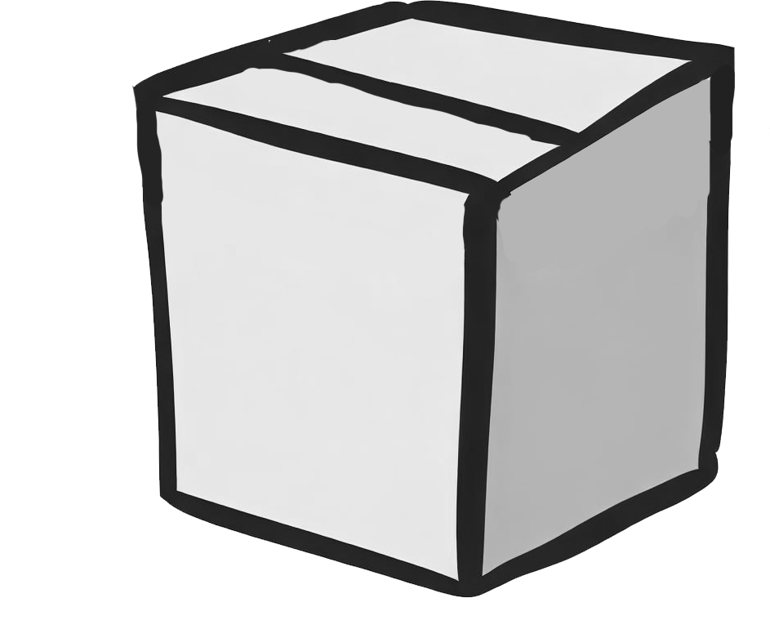
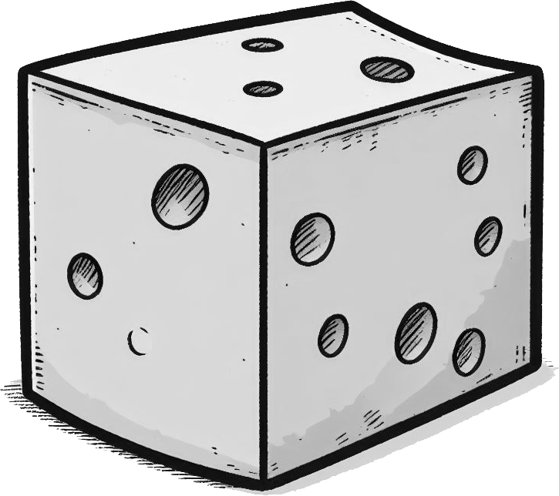

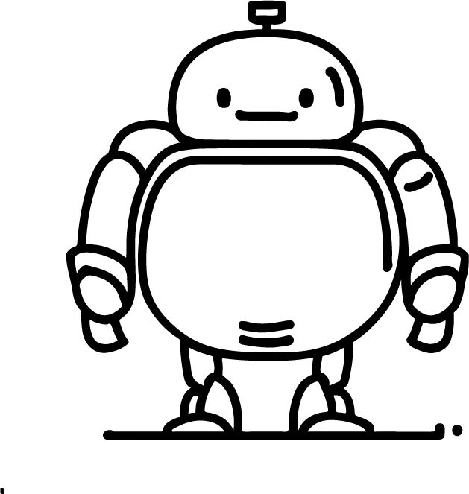



Describing more conversions with ratio
Images are not to scale.
2) Write the following in order from the lightest to the heaviest. Using the conversion 1 kg = 2.2 pounds
2.3 kg
4.18 pounds
4.62 pounds
2.05 kg
Correct order: cheese, sack, brick, box
3) Write the following in order from the shortest to the tallest. Using the conversion 1 inch = 2.54 cm
9.5 inches
20.32 cm
8.5 inches
22.86 cm
Correct order: feather, teddy bear, flower, robot
4) Write the following in order from the closest to the furthest from this sign. Using the conversion 5 miles = 8 km
14.6 km TOWN A
TOWN C 15.1 km
9 miles TOWN B
TOWN D 9.25 miles
Correct order: Town B, Town A, Town D, Town C
Mathematics in Education and Industry
v2.3

